Slide 1
Operator scaling++
Yuanzhi Li (Princeton)
Joint work with Zeyuan Allen-Zhu, Ankit Garg(Microsoft Research), Rafael Oliveria (University of Toronto) and Avi Wigderson (IAS)

Slide 2
Thanks:
My fiancée Yandi Jin

Slide 3
Problem of interest
Group action: A group G, a set V.
Each element g in G defines a map g: V -> V (actions).
The actions preserve the group structure:
(g₁g₂)(v) = g₁(g₂(v)) .
Identity(v) = v.

Slide 4
Problem of interest
Orbit intersection
Given elements v₁, v₂ in V, whether there are g₁, g₂ in G such that
g₁(v₁) = g₂(v₂).
Orbit closure intersection:
Suppose V is some metric space.
Given elements v₁, v₂ in V, consider two sets:
O(v₁) = { g(v₁) | g in G}, O(v₂) = { g(v₂) | g in G}.
Whether the closures of O(v₁) and O(v₂) intersect.
We want to do it efficiently.

Slide 5
Why is this problem interesting?
Graph isomorphism:
G: Symmetric group on n elements.
V: Set of graphs with n vertices.
An efficient algorithm (poly time) would be a huge break through.

Slide 6
How hard is this problem?
Orbit intersection: Unlikely to be NP-complete.
More like PIT (via invariant polynomials).

Slide 7
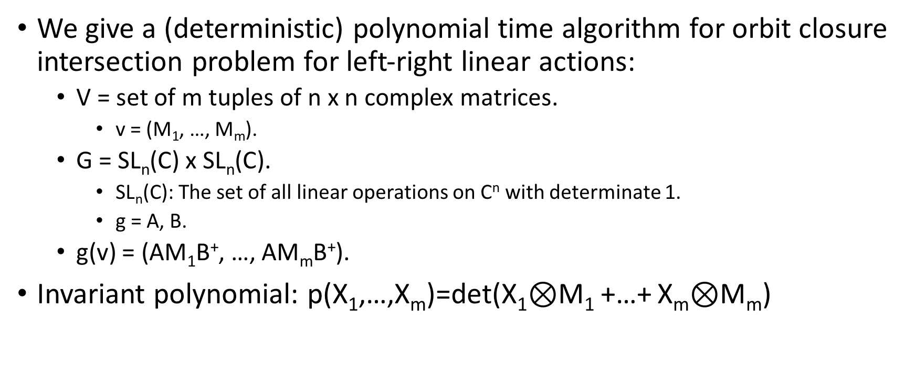
In this paper
We give a (deterministic) polynomial time algorithm for orbit closure intersection problem for left-right linear actions:
V = set of m tuples of n x n complex matrices.
v = (M₁, …, M_{m}).
G = SL_{n}(C) x SL_{n}(C).
SL_{n}(C): The set of all linear operations on C^{n} with determinate 1.
g = A, B.
g(v) = (AM₁B⁺, …, AM_{m}B⁺).
Invariant polynomial: p(X₁,…,X_{m})=det(X₁$⊗$M₁ +…+ X_{m}$⊗$M_{m})

Slide 8
The main problem:
Given v₁ = (M₁, …, M_{m}), v₂ = (M₁’, …, M_{m}’), decide whether for every œ > 0 there exists A, B in such that
||AM₁B⁺ - M₁’ ||_{F}² + … + ||AM_{m}B⁺ - M_{m}’||_{F}² < œ .
We give a polynomial time algorithm:
Polynomial in the number of bits to write down v₁, v₂.

Slide 9
Optimization approach
Let us focus on V = C^{n} (complex Euclidean space of dimension n), G is a subset of GL_{n}(C).
|| * ||₂ is the Euclidean norm.
Define f_{v}(g) = ||g(v)||₂².
Define N(v) = inf_{g in G} f_{v}(g).
Moment map: µ_{G}(v) .

Slide 10
Optimization approach
Kempf-Ness Theorem + Hilbert Nullstellansatz:
Suppose N(v₁), N(v₂) > 0, then there is an element in the intersection of the closures of O(v₁) and O(v₂) :
Then there is one v₀ in the intersection of the closures of O(v₁) and O(v₂) such that:
µ_{G}(v₀) = 0.
v₀ is unique in the sense that for every such v₀, v₀’, there exists s with:
v₀ = s(v₀’), where:
||s(v’)||₂ = ||v’||₂ for every v’ in V.
s is in the maximum compact subgroup K of G.

Slide 11
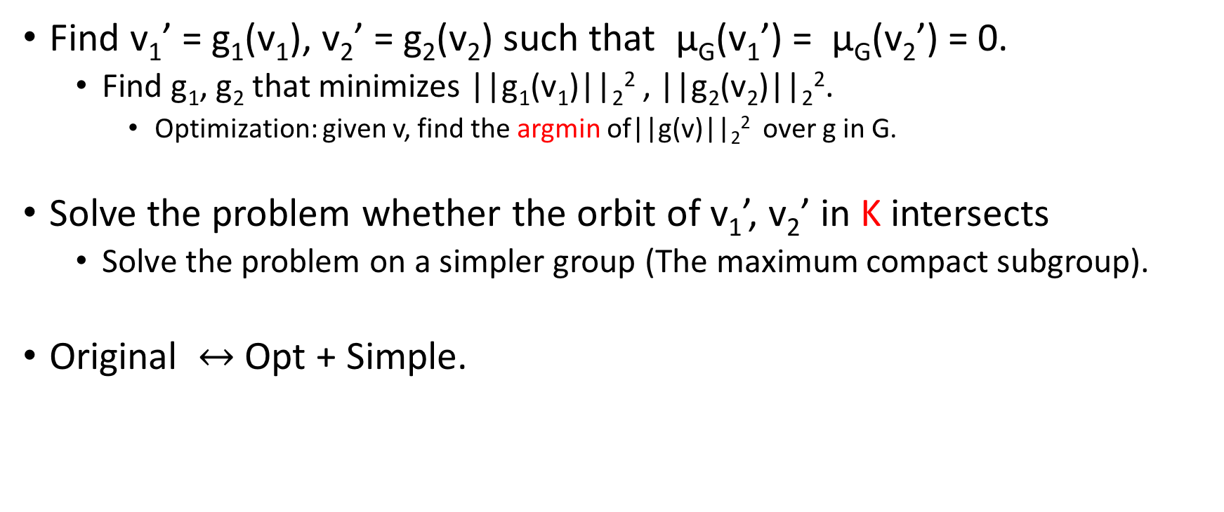
Two steps approach
Find v₁’ = g₁(v₁), v₂’ = g₂(v₂) such that µ_{G}(v₁’) = µ_{G}(v₂’) = 0.
Find g₁, g₂ that minimizes ||g₁(v₁)||₂² , ||g₂(v₂)||₂².
Optimization: given v, find the argmin of||g(v)||₂² over g in G.
Solve the problem whether the orbit of v₁’, v₂’ in K intersects
Solve the problem on a simpler group (The maximum compact subgroup).
Original $↔$ Opt + Simple.

Slide 12
The idea looks simple
But there is a problem:
The optimization step: Given v, find the argmin of||g(v)||₂² over g in G.
Usually, the theorems in optimization looks like this:
Given v, find g’ such that ||g’(v)||₂² ≤ Inf _{g in G}||g(v)||₂² + ϵ.
In some Time(1/ϵ).
Two reasons:
Infimum might not be achievable.
Infimum might not be a rational matrix (even when v is an integer vector).

Slide 13
Can we work inexactly?
One major difference between optimization and mathematics:
In math:
The exact minimizer has property blah blah blah.
If $ equals to ¥, then blah blah blah.
In optimization:
To get an efficient algorithm, most of the time we need to work with:
The approximate minimizer.
When $ approximately equals to ¥.

Slide 14
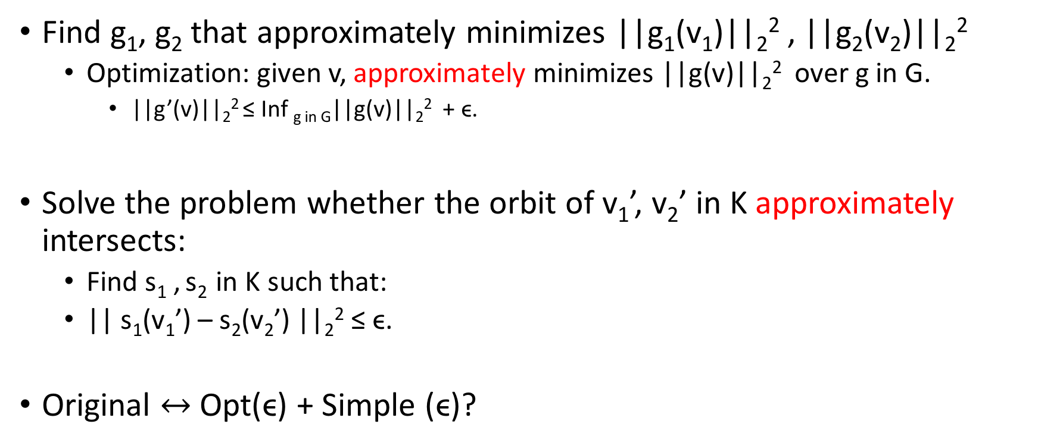
Two steps approach (Modified)
Find g₁, g₂ that approximately minimizes ||g₁(v₁)||₂² , ||g₂(v₂)||₂²
Optimization: given v, approximately minimizes ||g(v)||₂² over g in G.
||g’(v)||₂² ≤ Inf _{g in G}||g(v)||₂² + ϵ.
Solve the problem whether the orbit of v₁’, v₂’ in K approximately intersects:
Find s₁ , s₂ in K such that:
|| s₁(v₁’) – s₂(v₂’) ||₂² ≤ ϵ.
Original $↔$ Opt(ϵ) + Simple (ϵ)?

Slide 15
How to choose epsilon?
How fast we can minimize the given function?
Given v, find g’ such that ||g’(v)||₂² ≤ Inf _{g in G}||g(v)||₂² + ϵ
In some Time(1/ϵ).
What is this Time(1/ϵ)?
Logarithmic? log(1/ϵ)?
Polynomial? (1/ϵ)¹⁰?
Exponential? e^{1/ϵ}?
→ we want large epsilon so we can optimize fast.
How small the error needs so the mathematical theorems still hold:
→ we want small epsilon so we can prove the theorem easily.

Slide 16
How fast we can minimize the given function
Given v, minimize ||g(v)||₂² over g in G.
Theorem of [GRS’13, Wood’11]
For ‘most of the’ G: a subset of GL_{n}(C), V = C^{n}:
||g(v)||₂² is geodesically convex.

Slide 17
Geodesic Convexity
Equip some Riemannian metric ||*|| on G: a subset of GL_{n}(C).
Geodesic path from g₁ to g₂:
γ: [0, 1] -> G
γ(0) = g₁
γ(1) = g₂
For every s, t in [0,1]: || γ(s) - γ(t) || is proportional to |s - t|.
It can also be (uniquely) characterized by γ’(0).
A function f: G -> R is geodesically convex:
If and only if for every geodesic path γ:
f(γ): [0, 1] -> R is convex.

Slide 18
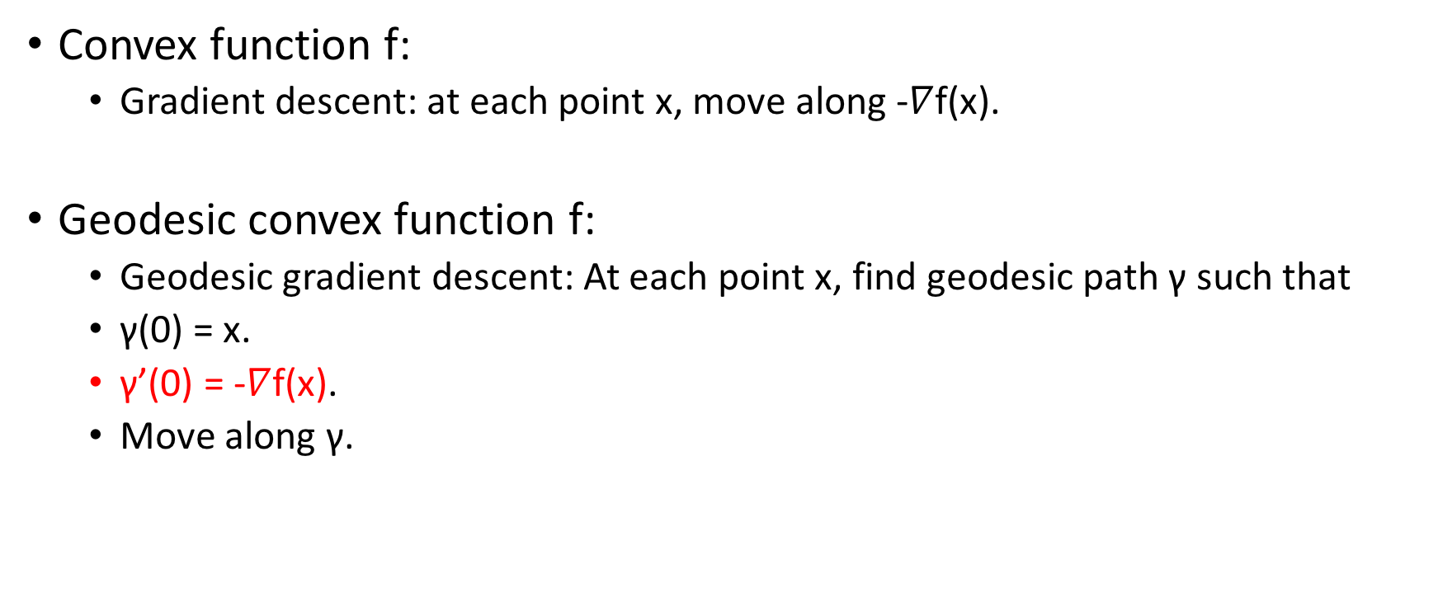
Minimize a geodesically convex function
Convex function f:
Gradient descent: at each point x, move along -$∇$f(x).
Geodesic convex function f:
Geodesic gradient descent: At each point x, find geodesic path γ such that
γ(0) = x.
γ’(0) = -$∇$f(x).
Move along γ.

Slide 19
Minimize a Geodesically convex function
Theorem[ZS’16]:
Using Geodesic gradient descent, we can minimize a geodesic convex function f up to error ϵ in time:
(1/ϵ)².
Polynomial time algorithm for (inverse) polynomially small ϵ.

Slide 20
Mathematical part
Can we prove the theorem when the error ϵ is inverse polynomial?
It is ok for applications in previous work: [GGOW’16] (Null Cone)
Not ok for our problem: We need exponentially small epsilon.

Slide 21
Mathematical part
The inexact orbit closure intersection problem:
Given tuples v₁ = (M₁, …, M_{m}) and v₂ = (M₁’, …, M_{m}’).
Our group G: SL_{n}(C) x SL_{n}(C).
The orbit closure of v₁ and v₂ intersects:
if and only if there exists (A, B) in G such that
||AM₁B⁺ - M₁’||_{F}² + … + ||AM_{m}B⁺ - M_{m}’||_{F}² ≤ ϵ.
Central question: How small ϵ needs to be?

Slide 22
Mathematical part
Theorem (this paper): epsilon being (inverse) exponentially small is sufficient:
There exists a polynomial p: R³ -> R such that for every m, n, B, every v₁ = (M₁, …, M_{m}) and v₂ = (M₁’, …, M_{m}’) where M_{i}, M_{i}’ in C^{n x n} with each entry being integers in [-B, B], the following two statements are equivalent:
The orbit closure of v₁ and v₂ intersects.
There exists (A, B) in G such that ||AM₁B⁺ - M₁’||_{F}² + … + ||AM_{m}B⁺ - M_{m}’||_{F}² ≤ e^{-p(m, n, log B)}.
(inverse) exponential is tight.

Slide 23
Epsilon is inverse exponentially small
To get an efficient algorithm, we need to:
Given v, find g’ such that ||g’(v)||₂² ≤ Inf _{g in G}||g(v)||₂² + ϵ.
In time polylog(1/ϵ).
Which means that we can not use gradient descent.

Slide 24
Faster optimization algorithms
Optimization algorithm with polylog(1/ϵ) convergence rate:
In convex setting:
Newton’s method (Only local convergence rate).
Interior point algorithm.
Ellipsoid algorithm.

Slide 25
Faster optimization algorithms:
Newton’s method (Only local convergence rate).
Interior point algorithm.
They are ‘gradient descent’ type of algorithms.
They all based on the so called ``self-concordant function’’.

Slide 26
Self-concordant function:
A convex function f: R -> R is self-concordant if for every x:
|f’’’(x)| ≤ 2 (f’’(x))^{3/2}.
Scaling independent: |f’’’(ax)| ≤ 2 (f’’(ax))^{3/2} for every non-zero a.
A geodesically convex function is self-concordant if for every geodesic path γ, f(γ): R -> R is self-concordant.

Slide 27
Self-concordant function:
A convex function f: R -> R is self-concordant if for every x:
|f’’’(x)| ≤ 2 (f’’(x))^{3/2}
‘looks likes’ Quadratic function:
When the second order derivative is small, the change of it is also small.

Slide 28

Optimize a self-concordant function:
Forklore (informal): There is an algorithm that runs in time poly(n)log(1/ϵ) to minimize a geodesic self-concordant function: G -> R up to accuracy ϵ.
Move along direction -($∇^{2}$f(x))⁻¹$∇$f(x).

Slide 29
Good, can we use it?
No…
Our function ||g(v)||₂² is not geodesic self-concordant …

Slide 30
Ok, can we modify the definition?
|f’’’(x)| ≤ 2 (f’’(x))^{3/2}
Why 3/2? I don’t like 3/2… it’s not an integer… not nice…
Scaling independent.
Can we fix a scaling and use other powers?

Slide 31
Self-robust function:
A function f: R -> R is self-robust if for every x:
|f’’’(x)| ≤ f’’(x).
A geodesic convex function is self-concordant if for every unit speed geodesic path γ, f(γ): R -> R is self-concordant.
Unit speed: ||γ’(0)|| = 1.

Slide 32
Optimize a self-robust function:
Theorem [This paper, informal]: There is an algorithm that runs in time poly(n)log(1/ϵ) to minimize a geodesic self-robust function: G -> R up to accuracy ϵ. (G is a subset of GL_{n}(C))

Slide 33
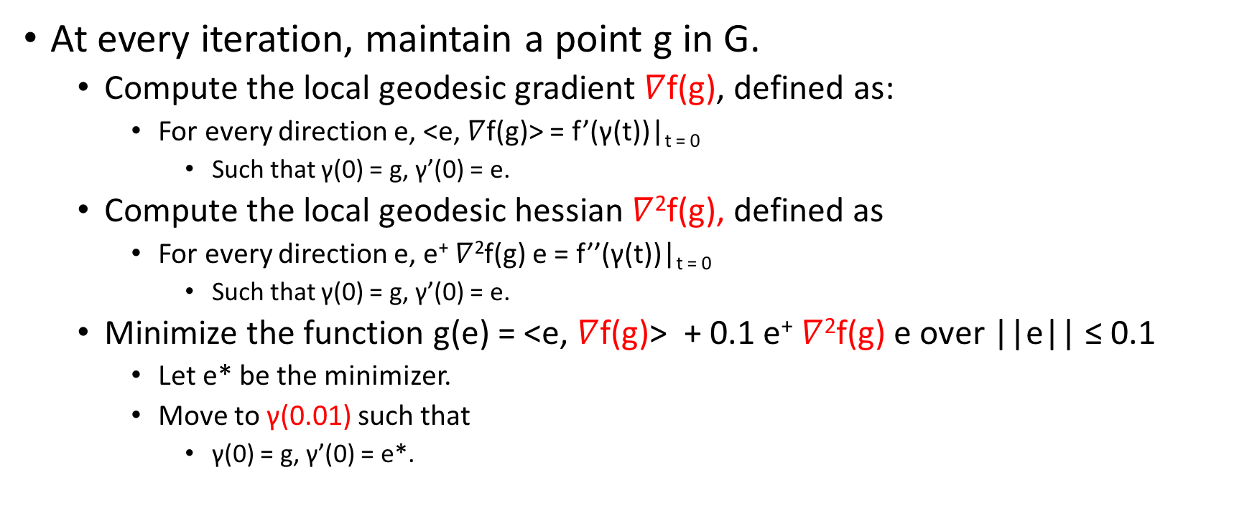
Overview of the algorithm:
At every iteration, maintain a point g in G.
Compute the local geodesic gradient $∇$f(g), defined as:
For every direction e, <e, $∇$f(g)> = f’(γ(t))|_{t = 0}
Such that γ(0) = g, γ’(0) = e.
Compute the local geodesic hessian $∇$²f(g), defined as
For every direction e, e⁺ $∇$²f(g) e = f’’(γ(t))|_{t = 0}
Such that γ(0) = g, γ’(0) = e.
Minimize the function g(e) = <e, $∇$f(g)> + 0.1 e⁺ $∇$²f(g) e over ||e|| ≤ 0.1
Let e* be the minimizer.
Move to γ(0.01) such that
γ(0) = g, γ’(0) = e*.

Slide 34

Wait a second…
Why $∇$f(g), $∇$²f(g) even exist?
It is important that γ is geodesic path.
Can be defined via ‘Exponential map’.

Slide 35
Good, can we use it?
No…
Our function ||g(v)||₂² is not geodesic self-robust…

Slide 36
Wait… so what are you talking about???

Slide 37
Modify the function
We just need to find the minimizer g in G of ||g(v)||₂².
We can minimize any function h_{v}(g) such that
argmin _{g in G} h_{v}(g) = argmin _{g in G}||g(v)||₂².
Can we find such function? And make it self-concordant/self-robust?

Slide 38
The log capacity function:
In our problem:
v = (M₁, …, M_{m}), g = (A, B).
||g(v)||₂² ⁼ ||AM₁B⁺ ||_{F}² + … + ||AM_{m}B⁺||_{F}² .
Minimizing this function is aka operator scaling.
The equivalent function: log capacity function: for a PSD matrix X,
f(X) = logdet(M₁XM₁⁺ + … + M_{m}XM_{m}⁺) – logdet(X).
Theorem [Gurvits’04]:
Let X* be a minimizer of f(X), let A*, B* be the minimizer of ||g(v)||₂² , then there exists a, b in R such that
B⁺B = a X*.
AA⁺ = b(M₁XM₁⁺ + … + M_{m}XM_{m}⁺).

Slide 39
Log capacity function:
Theorem [This paper]:
f(X) = logdet(M₁XM₁⁺ + … + M_{m}XM_{m}⁺) – logdet(X)
Is a geodesic self-robust function, with the geodesic path over PSD matrices given as:
γ(t) = X₀^{1/2}e^{tD}X₀^{1/2}
γ(0) = X₀
γ'(0) = X₀^{1/2}DX₀^{1/2}.

Slide 40
Step 1:
Minimize:
f₁(X) = logdet(M₁XM₁⁺ + … + M_{m}XM_{m}⁺) – logdet(X) .
f₂(X) = logdet(M₁’XM₁^{’+} + … + M_{m}’XM_{m}^{’+}) – logdet(X) .
Let X₁*, X₂* be an ϵ-approximate minimizers.
Let:
B⁺B = a₁ X₁*, B₂⁺B₂ = a₂ X₂*.
AA⁺ = b₁(M₁X₁*M₁⁺ + … + M_{m}X₁*M_{m}⁺), A₂A₂⁺ = b₂(M₁’ X₂* M₁’⁺ + … + M_{m}’ X₂* M_{m}’⁺) .

Slide 41
Step 2:
Now, let w₁ = Av₁B⁺, w₂ = A₂v₂B₂⁺.
Check the orbit closure w_{1,} w₂ approximately interests in a subgroup K:
K: all the elements g in G such that for every v in V, ||g(v)||₂² = ||v||₂²
In this problem: K: the set of all (determinate one) unitary matrices.

Slide 42
Exact unitary equivalence:
Given w₁ = (M₁, …, M_{m}), w₂ = (M₁’, …, M_{m}’),
Check whether there exists unitary matrices U, V such that
For all i in m: U M_{i} V⁺ = M_{i}’.
Existing algorithms [CIK’97, IQ’18] can solve it in polynomial time.

Slide 43
Inexact unitary equivalence:
Given w₁ = (M₁, …, M_{m}), w₂ = (M₁’, …, M_{m}’),
Check whether there exists unitary matrices U, V such that
For all i in m: ||U M_{i} V ⁺ - M_{i}’||_{F} ≤ ϵ.
Where ϵ is (inverse) exponentially small.

Slide 44
Naïve idea
Given w₁ = (M₁, …, M_{m}), w₂ = (M₁’, …, M_{m}’),
Check whether there exists unitary matrices U, V such that
For all i in m: ||U M_{i} V ⁺ - M_{i}’||_{F} ≤ ϵ.
Where ϵ is (inverse) exponentially small.
Make ϵ smaller than (inverse) exponential of the bit complexity of M_{i} and M_{i}’.
So U M_{i} V ⁺ = M_{i}’.
Use exact algorithm.

Slide 45
Recall how we get w₁
Minimize:
f₁(X) = logdet(M₁XM₁⁺ + … + M_{m}XM_{m}⁺) – logdet(X).
f₂(X) = logdet(M₁’XM₁^{’+} + … + M_{m}’XM_{m}^{’+}) – logdet(X).
Let X₁*, X₂* be an ϵ-approximate minimizers.
Let:
B⁺B = a₁ X₁*, B₂⁺B₂ = a₂ X₂*.
AA⁺ = b₁(M₁X₁*M₁⁺ + … + M_{m}X₁*M_{m}⁺), A₂A₂⁺ = b₂(M₁’ X₂* M₁’⁺ + … + M_{m}’ X₂* M_{m}’⁺).

Slide 46
Naïve idea
Given w₁ = (M₁, …, M_{m}), w₂ = (M₁’, …, M_{m}’):
w₁ = Av₁B⁺, where A, B defined by an ϵ-approximate minimizer.
The smaller ϵ is, the larger the bit complexity of M_{i} is.
In fact, ϵ can never be smaller than (inverse) exponential of the bit complexity of M_{i} and M_{i}’.

Slide 47
This paper
We give an algorithm that runs in time poly(m, n, log 1/ϵ, B) that
Given w₁ = (M₁, …, M_{m}), w₂ = (M₁’, …, M_{m}’),
Distinguish whether there exists unitary matrices U, V such that
For all i in m: ||U M_{i} V ⁺ - M_{i}’||_{F} ≤ ϵ.
There exists i in m: ||U M_{i} V ⁺ - M_{i}’||_{F} ≥ exp(poly(m, n))ϵ^{1/poly(m, n)}.
It applies to any ϵ, regardless of the bit complexity B of w₁ , w₂ .

Slide 48
In exact algorithm: Step 1
What do we know if there exists unitary U, V such that
||U M V ⁺ – M’||_{F} ≤ ϵ.
Singular value decomposition.

Slide 49
Singular value decomposition (SVD)
For every matrix M in C^{n x n}:
There exists unitary matrices U, V and a diagonal matrix Σ = diag(σ₁, …, σ_{n}) with σ₁≥ σ₂ ≥ … ≥ σ_{n} ≥ 0 such that:
M = UΣV⁺.

Slide 50
Gap-free Wedin Theorem
What do we know if there exists unitary U, V such that
||U M V ⁺ – M’||_{F} ≤ ϵ ?
Theorem [AL’16]: Let M = U₁ΣV₁⁺, M’ = U₂ΣV₂⁺ be the SVD of M, M’. Suppose ||U M V ⁺ – M’||_{F} ≤ ϵ . For every δ ≥ 0, if
There exists k in [n - 1] such that σ_{k} – σ_{k+1} ≥ δ
Then ||U₁₁ ⁺ U⁺U₂₂ ||_{F} ≤ ϵ/(δ - 2ϵ).
U₁₁: First k columns of U₁, U₂₂: Last n – k columns of U₂

Slide 51
Gap-free Wedin Theorem
||U₁₁ ⁺ U⁺U₂₂ ||_{F} ≤ ϵ/(δ - 2ϵ).
If we write U = U₂U’U₁⁺ for an unitary matrix U’.
Then U’ is close to being (block) diagonal.

Slide 52
Apply gap-free Wedin Theorem
Suppose ||U M_{i} V ⁺ - M_{i}’||_{F} ≤ ϵ and M_{i} has a singular value gap δ
Then we can find in polynomial time unitary U’, U’’, V’, V’’ such that there exists unitary matrices U₁, U₂, V₁, V₂:
|| U - U’ diag(U₁, U₂) U’’⁺ ||_{F} ≤ ϵ/(δ - 2ϵ).
|| V - V’ diag(V₁, V₂) V’’⁺ ||_{F} ≤ ϵ/(δ - 2ϵ).
Reduce the original problem to two sub problems of smaller dimensions.

Slide 53
In the end:
Left with a problem where all M_{i} has no singular value gap:
M_{i} is close to a (constant multiple of) unitary matrix.
||U M_{i} V ⁺ - M_{i}’||_{F} ≤ ϵ where M_{i}, M_{i}’ are close to unitary:
V is close to M_{i}’⁺UM.
So we can reduce one unitary V and focus only on U.

Slide 54
Inexact unitary conjugation:
Given w₁ = (M₁, …, M_{m}), w₂ = (M₁’, …, M_{m}’),
Check whether there exists unitary matrices U such that
For all i in m: ||U M_{i} U ⁺ - M_{i}’||_{F} ≤ ϵ.
Where ϵ is (inverse) exponentially small.

Slide 55
Eigenvalue
The eigenvalues of a matrix M is given by the set of all values λ in C such that
Det(λI - M) = 0.

Slide 56
Eigenvalue Wedin Theorem
What do we know if there exists unitary U such that
||U M U⁺ – M’||_{F} ≤ ϵ.
Theorem [This paper]: Suppose ||U M U⁺ – M’||_{F} ≤ ϵ, then for every δ ≥ 0, if M has two eigenvalues λ₁, λ₂ such that | λ₁ - λ₂| ≥ δ,
We can compute, in time poly(n, log1/ϵ) unitary matrices U’, U’’ such that there exists unitary matrices U₁, U₂:
|| U - U’ diag(U₁, U₂) U’’⁺||_{F} ≤ ϵ/(δ/n - 2ϵ).

Slide 57
Apply eigenvalue Wedin Theorem
Suppose ||U M_{i} U ⁺ - M_{i}’||_{F} ≤ ϵ and M_{i} has a eigenvalue gap δ:
Then we can find in polynomial time unitary matrices U’ ,U’’ such that there exists unitary matrices U₁, U₂
|| U - U’ diag(U₁, U₂) U’’⁺ ||_{F} ≤ ϵ/(δ/n - 2ϵ).
Reduce the original problem to two sub problems of smaller dimensions.

Slide 58
In the end:
Left with a problem where all M_{i} has no singular value gap nor eigenvalue gap.
Theorem [This paper]: M_{i} is close to (constant multiple of) identity.

Slide 59
Summary
We give a polynomial time algorithm for orbit closure intersection problem for left-right linear actions:
V = set of m tuples of n x n complex matrices.
v = (M₁, …, M_{m}).
G = SL_{n}(C) x SL_{n}(C).
g = A, B.
g(v) = (AM₁B⁺, …, AM_{m}B⁺).

Slide 60
Summary
Use geodesic optimization to reduce the original problem to inexact unitary equivalence problem.
Inexact theorem holds for (inverse) exponentially small epsilon.
Mathematics.
Design an algorithm with linear convergence rate.
Optimization.
Design a new algorithm for inexact unitary equivalence problem.

